Slide 1
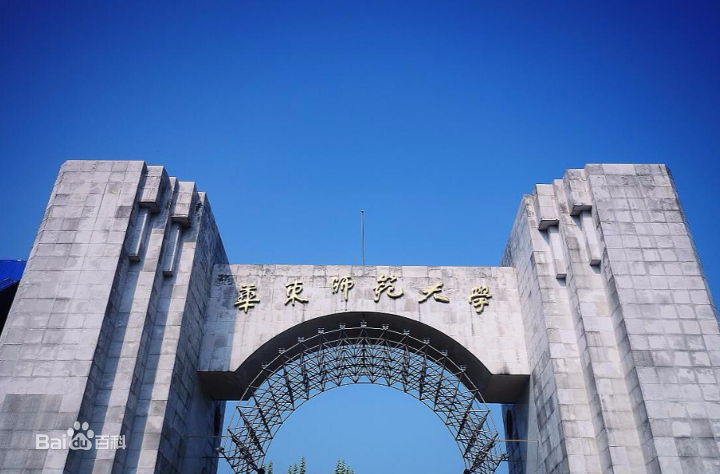
Self-Balancing Federated Learning With Global Imbalanced Data in Mobile Systems
IEEE TRANSACTIONS ON PARALLEL AND DISTRIBUTED SYSTEMS
Yifan Bu 2020.9.8

Slide 2

The main contributions of the paper
Find out that the global imbalanced training data will degrade the accuracy of CNN models trained by FL
Propose a self-balancing federated learning framework, Astraea, along with two strategies to prevent the bias of training caused by imbalanced data distribution.
contributions
The experimental results show that Astraea can efﬁciently retrieve 52.0 percent accuracy loss on imbalanced EMNIST and retrieve 46.9 percent accuracy loss on imbalanced CINIC-10 dataset

Slide 3
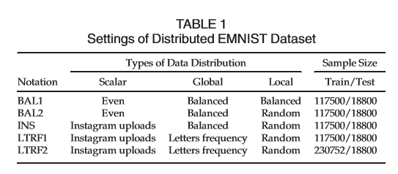
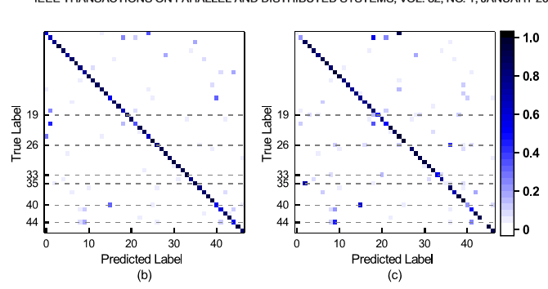
The impact of imbalanced training data on federated learning
The random local imbalance does not lead to accuracy degradation, the accuracy on BAL1 and BAL2 is 81.40 and 80.98 percent. （BAL1 VS BAL2）
BAL1
LTRF1
The test accuracy is slightly improved +2.31 percent in the scalar imbalance case (from 80.98 to 83.29percent).
(BAL2 VS INS)
In summary, the global imbalance will cause an accuracy loss of the model trained through FL.
(BAL1 VS LTRF1)

Slide 4


Mathematical Demonstration
1.federated learning cannot achieve optimal weights when training data distribution is imbalanced.
2. is true for t is any non-negative integer and

Slide 5
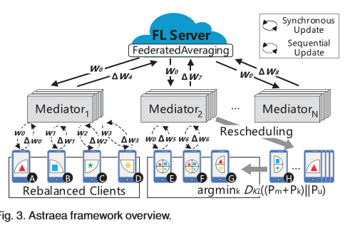
Astraea Framework
Astraea consists of three parts: FL server, mediator, and clients
FL server:maintain model,deploy mediator,aggregate updates
Mediators:reschedule the training processing, make the distribution of the collection of data close to the uniform
Clients:
Uniform clients(enough data and balance)
Slight clients(small size of data)
Skewed(enough data and imbalance)
The slight clients and skewed clients introduce scalar imbalance and local imbalance respectively.

Slide 6
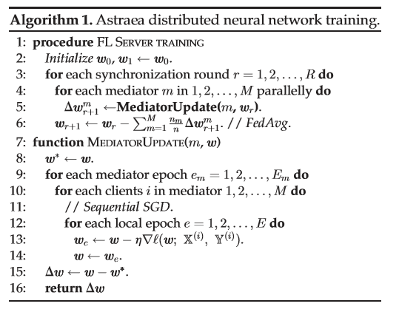
Algorithm1.Astraea distributed neural network training

Slide 7
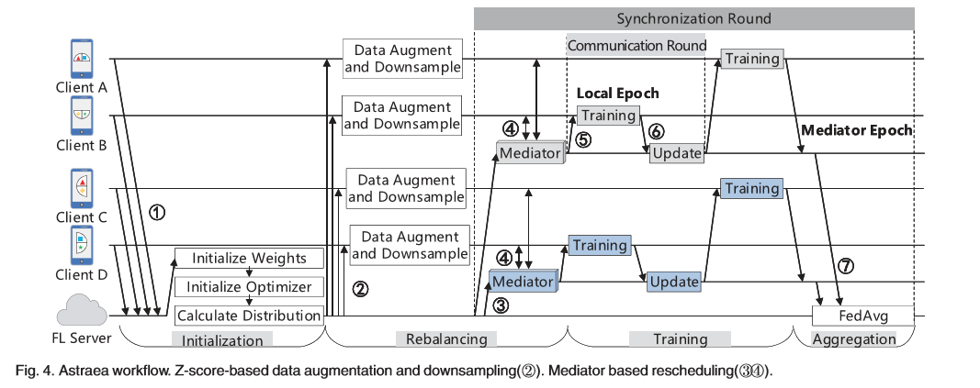
Astraea Workﬂow
1.The devices participate in the training by sending their local data distribution information to the server
2.Perform the z-score-based data augmentation and downsampling.(Algorithm 2 global imbalance)
3.Create mediator
4.Reschedule clients’ training.(3,4 Algorithm 3 local imbalance)
5. At the beginning of each communication round, each mediator sends the model to the subordinate clients.
6. The mediator receives the updated model
7. All the mediators send the updates of models to the FL server

Slide 8
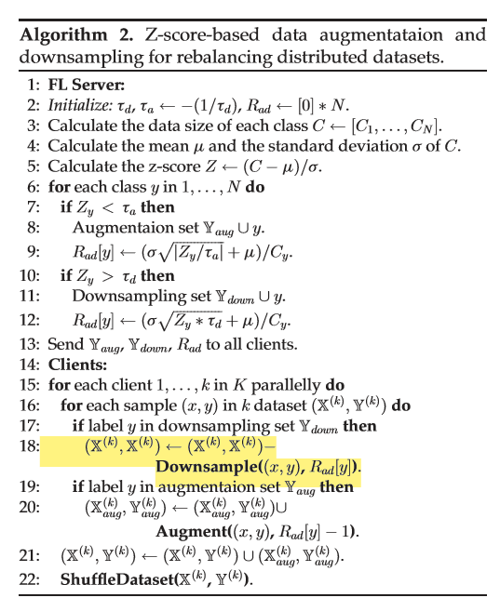
Algorithm 2. Z-score-based data augmentataion and
downsampling for rebalancing distributed datasets
The Rad is the ratio we use to control how many augmentations are generated or how many samples are retained
A class as majority class (denote as Ydown) or minority class (denote as Yaug) if its z-score of class size is greater than td or less than ta.

Slide 9
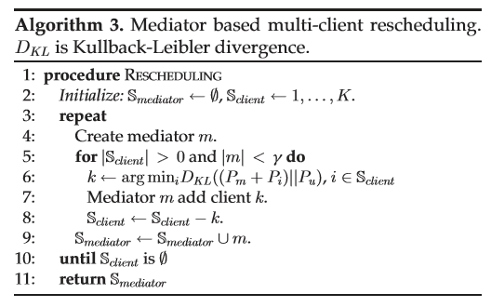
Algorithm 3. Mediator based multi-client rescheduling.
Minimize the KLD between mediator’s data distribution Pm and uniform distribution Pu.

Slide 10
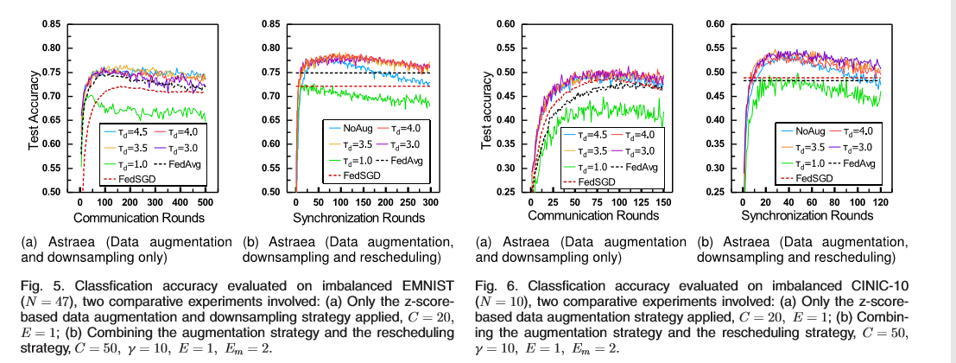
Experiment
Augmentation Versus Mediator.
Datasets:
Imbalanced EMNIST
Imbalanced CINIC-10 [19] and the CIFAR-10
Baseline: FedAvg
The improved accuracy achieved by the z-score-based data augmentation strategy and the improved accuracy achieved by combining augmentation and rescheduling.
the recommended range for td is 3.0 to 3.5,
the top-1 test accuracy
No Aug in Fig.5b acc increase,but overfitting.
Consider the maximum test accuracy during training procedure as the ﬁnal accuracy of the model, which will ignore the effects of overﬁtting.

Slide 11
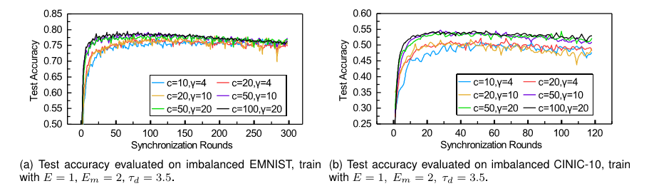
Experiment
c versus gamma
c is the number of online clients per communication round
gamma is the max assigned clients limitation of the mediator
The training of model converges faster with the increase of c, after 150 rounds, the accuracy is slightly reduced, especially for the models trained with a large c.
A larger gamma does not help to improve the accuracy of the model.
Use the regularization strategy called early stopping to remedy overfitting.

Slide 12
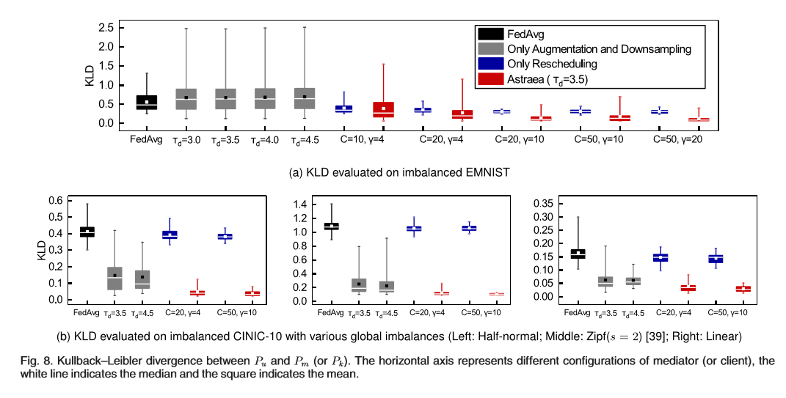
Experiment
the KLD of all clients or mediators
left-skewed
FedAvg is most imbalanced(black)
Augmentation-only may increase local imbalance and introduce some new outliers.(grey)
Rescheduling-only can achieve partial equilibrium, the outliers are signiﬁcantly reduced and the mean of KLD is slightly lower. (blue)
The results show that a larger c or g can reduce the range of KLD.
Combining two strategies can signiﬁcantly rebalance data distribution (red)
Astraea signiﬁcantly reduces the KLD, compared to FedAvg or the single strategy case.

Slide 13
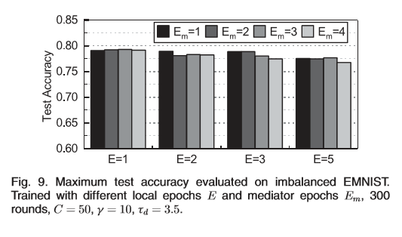
Experiment
Local Epochs Versus Mediator Epochs
Increasing local epochs does not bring signiﬁcant improvement in accuracy.
Increasing Em does not signiﬁcantly help improve the accuracy of the model
Can reduce communication overhead by increasing Em to accelerate the convergence of the model. ->（Communication Overhead）

Slide 14



Experiment
Time overhead
Time
augmentation
once at the initialization phase
negligible
a greedy strategy
static data distribution
only performs rescheduling once
rescheduling
dynamic data distribution
reschedule in each synchronization round

Slide 15
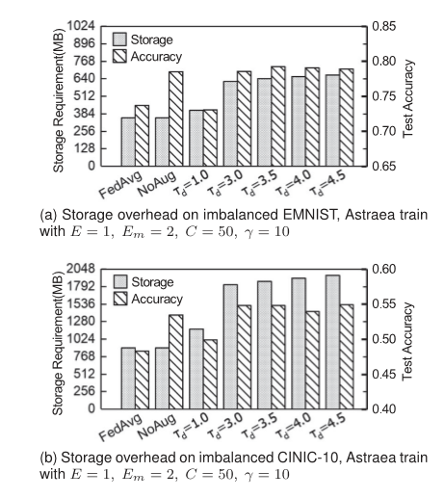
Experiment
Storage overhead
requires the clients to provide additional storage space to store the augmented samples.
The data augmentation strategy is necessary, and the model in NoAug is prone to overﬁtting

Slide 16
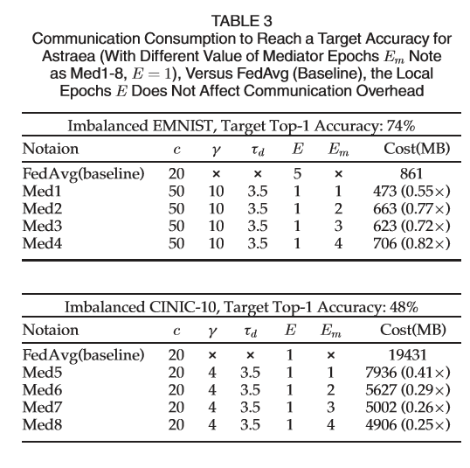
Experiment
Communication overhead
Due to the training of the clients in each mediator is squential, each synchronization round in Astraea costs more trafﬁc than each communication round in FL.
The trafﬁc of each communication round
The trafﬁc of each synchronization round
Astraea requires fewer communication costs that FL in achieving a required accuracy.

Slide 17
Related Work
1.Previous work on the imbalanced data learning in FL focused on the non-IID data.
2.Conclusions by author: FedAvg is roboust to non-IID data(EMINIST).（different from Zhao et al. ）
3. Our work focuses on the global imbalance challenge in FL.
4. In order to distinguish from the previous works about non-IID data, we adopt the random distribution as the local data distribution.
5.Agnostic Federated Learning (AFL), which is designed to minimize the training loss calculated based on any possible weighted combination of clients’ domain.
6.Chen et al. [48] propose a federated meta-learning framework named FedMeta
7.Luo et al. [49] propose a real-world image datasets for federated learning, where the training data is natural non-IID and global imbalancd.

Slide 19

Made by Yifan Bu
2020.9.8
THANK YOU

